Slide 1

BRYPT BANK SYSTEM
Developers
Balakrishnan N
Ragul Raj A
Yogeshwaran J
Prabhu S
Mohamed Thoufeeq B

Slide 2

OUR BIG IDEA
This project is to develop software for bank management system. This project has been developed to carry out the processes easily and quickly, which is not possible with the manuals systems, which can be overcomed by this software. This project is developed using springboot . Hence it provides the complete solution for the current management system.

Slide 3
PROJECT DESCRIPTION
The bank Management application system is an application for maintaining a personal account in a bank. The application should have two types of users (a regular user represented by the front desk employee and an administrator user) who have to provide a username and a password in order to use the application.

Slide 4


Administrator Operations
Create/update/delete/view client account (account information:, type, amount of money, date of creation). identification number
CRUD on customers’ information.
Add/update/view client information (name, identity card number, personal numerical code, address, etc.)

Slide 5
Regular User Operation
Depositing money to their account balance
Adding Beneficiary
Transfer money between accounts.
Process utilities bills.

Slide 6

USE CASE- Model
Use case: Transact money between two accounts.
Level: user-goal level
Primary actor: Regular customer (User)
Main Success Scenario:
Action | System Response
Access the web application | The login page is displayed
Log in | The user is directed to the home page
Click on transaction | Display the form to be completed
Enter the id for both accounts with the amount to be transferred. | The system checks if the transaction is possible and if so it executes the transaction.
Extensions: The id of either one of the account is not a valid then transaction cannot be performed.

Slide 7
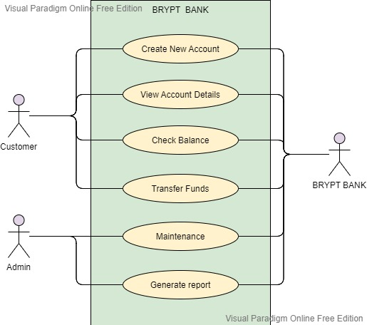
USECASE DIAGRAM
Create new account

Slide 8
ER- Model
An entity-relationship diagram (ERD) represents the relationships among entity sets stored in a database.
An entity in this context is a component of data. We can say that ER diagrams illustrate the logical structure of database.

Slide 9
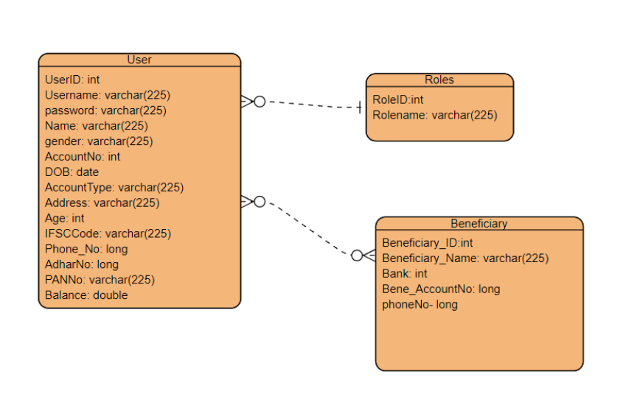
ER DIAGRAM

Slide 10


Attributes
Beneficiary Attributes
Beneficiary_id
Beneficiary _name
Bank
Beneficiary_AccNo
PhoneNo

Slide 11
Attributes
User Attributes
User_id
UserName
Name
Gender
Dob
Age
PhoneNo
AccountNo
Address
Email
Password
Acctype_Type
Balance
IFSCCode
AdharNo
PanNo

Slide 12
Attributes
Role Attributes
Role_id
Role_name

Slide 13

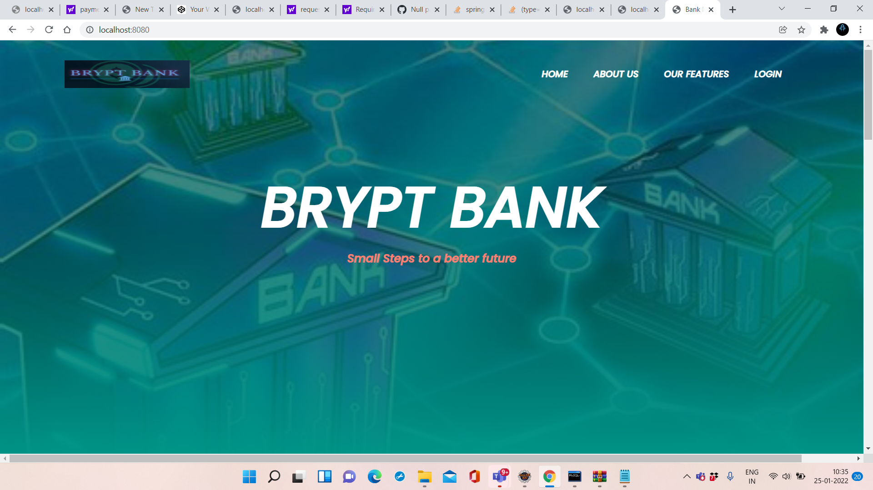
MODULES
____________
This is the home page where everyone sees first.
Here, we have three options, AboutUs, Our Features, Login.

Slide 14
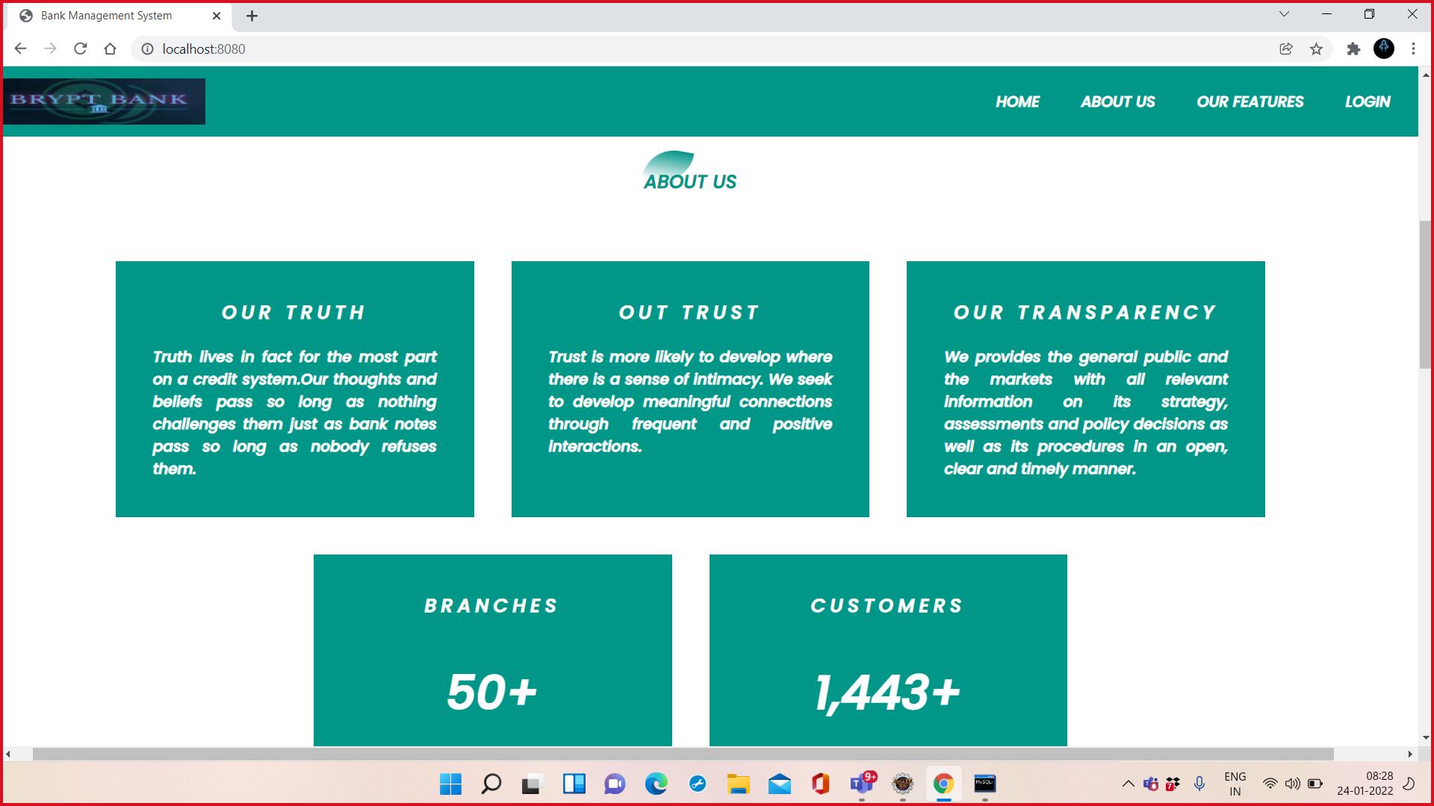

Slide 15
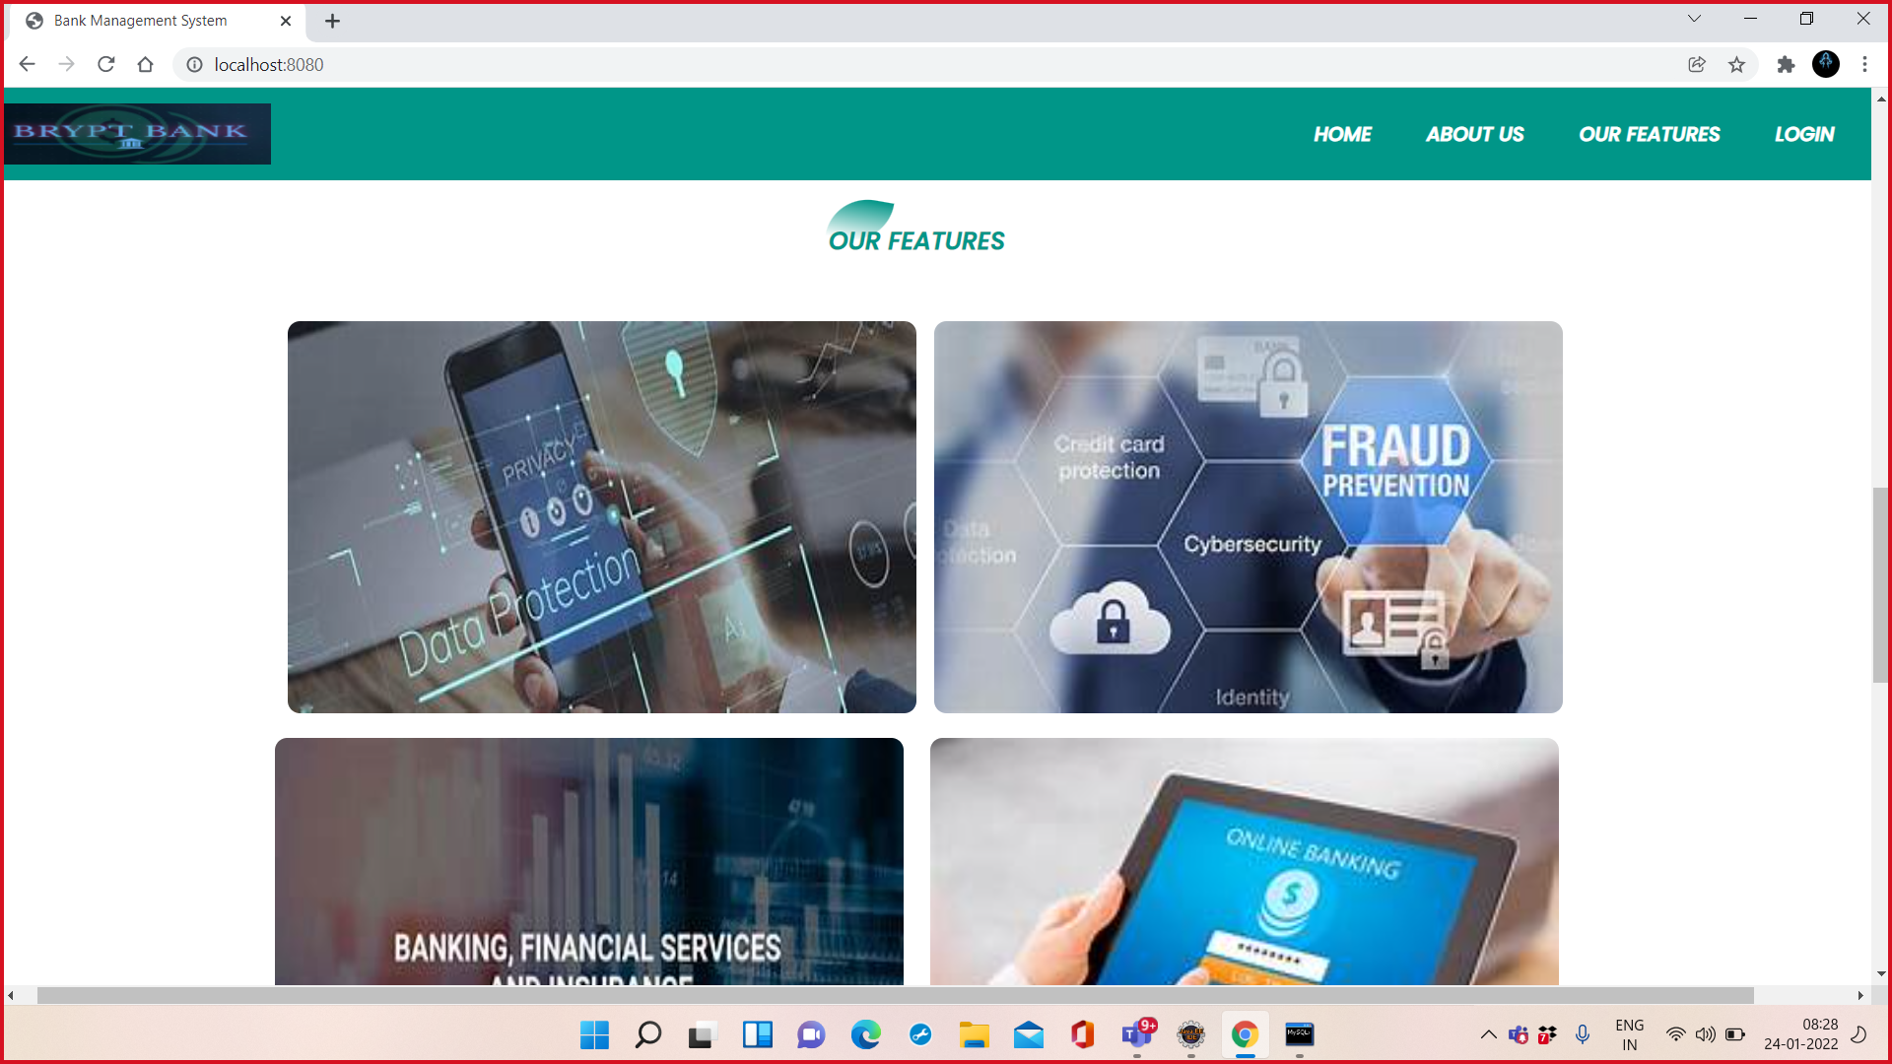

Slide 16
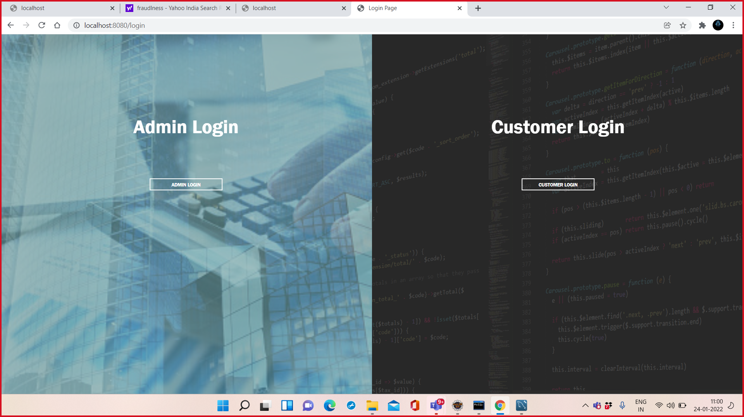
LOGIN PAGE
________________
Here, There are two types of login namely Admin Login and Customer Login.
When the admin or customer who were already registered can login with correct username and password, they will be redirect to their dashboard.

Slide 17
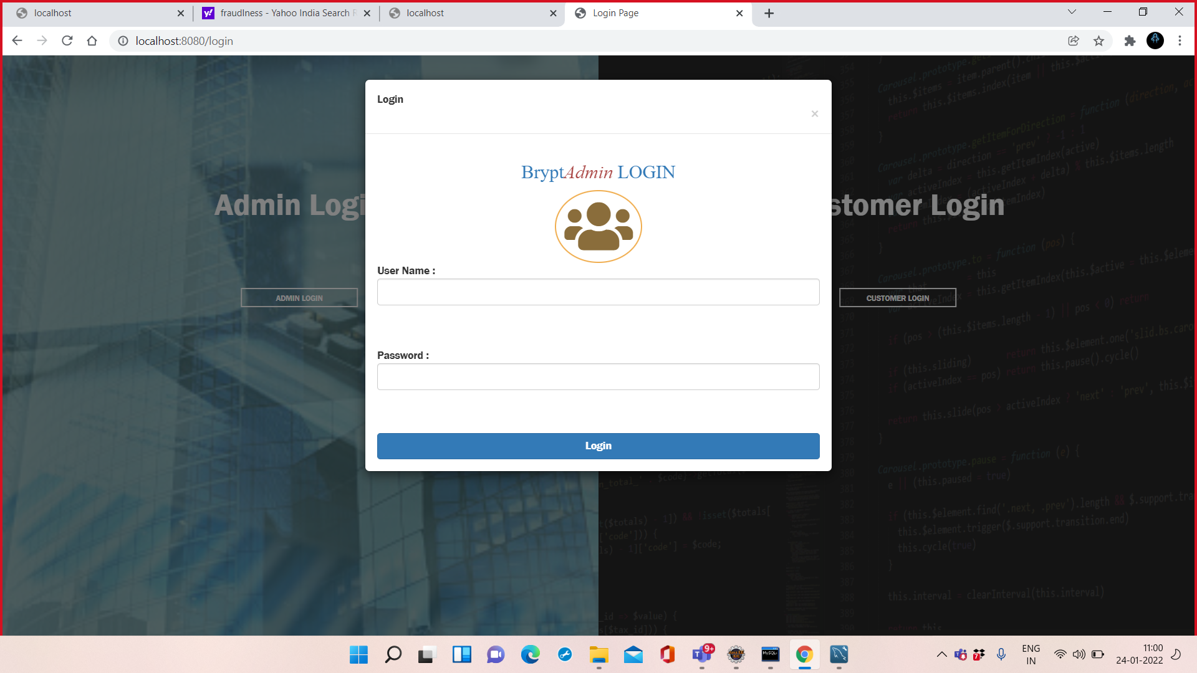
ADMIN LOGIN
________________
When admin enters correct username and password, they will be redirect to their dashboard.
There, they have certain functions like add customers, edit/delete customer details.

Slide 18
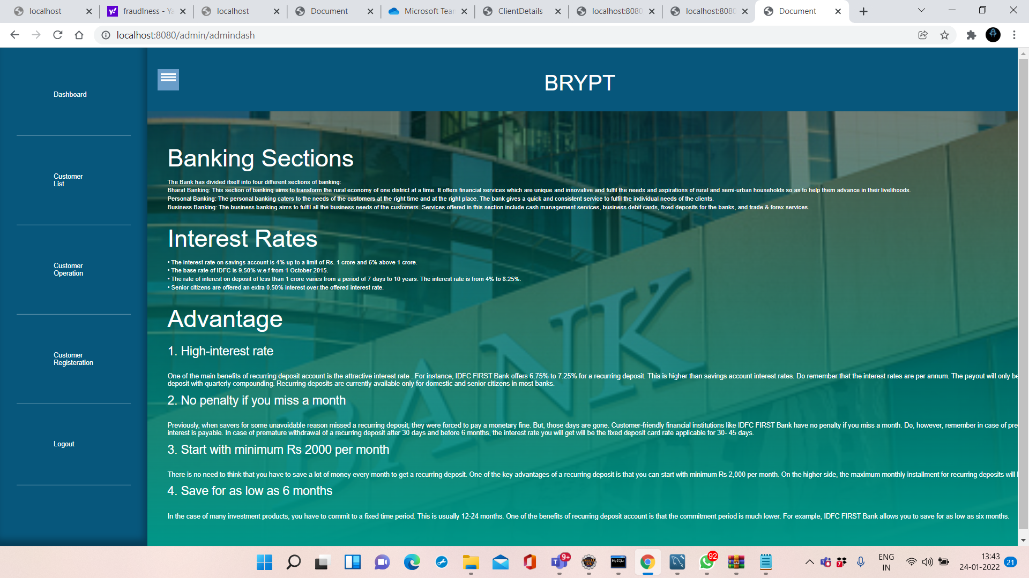
ADMIN DASHBOARD
_______________________
After entering the correct username and password, the admin is redirected to this dashboard.
Here, there is a brief details about the bank policies and admin have certain functions like register customer, customer list, customer operations.

Slide 19
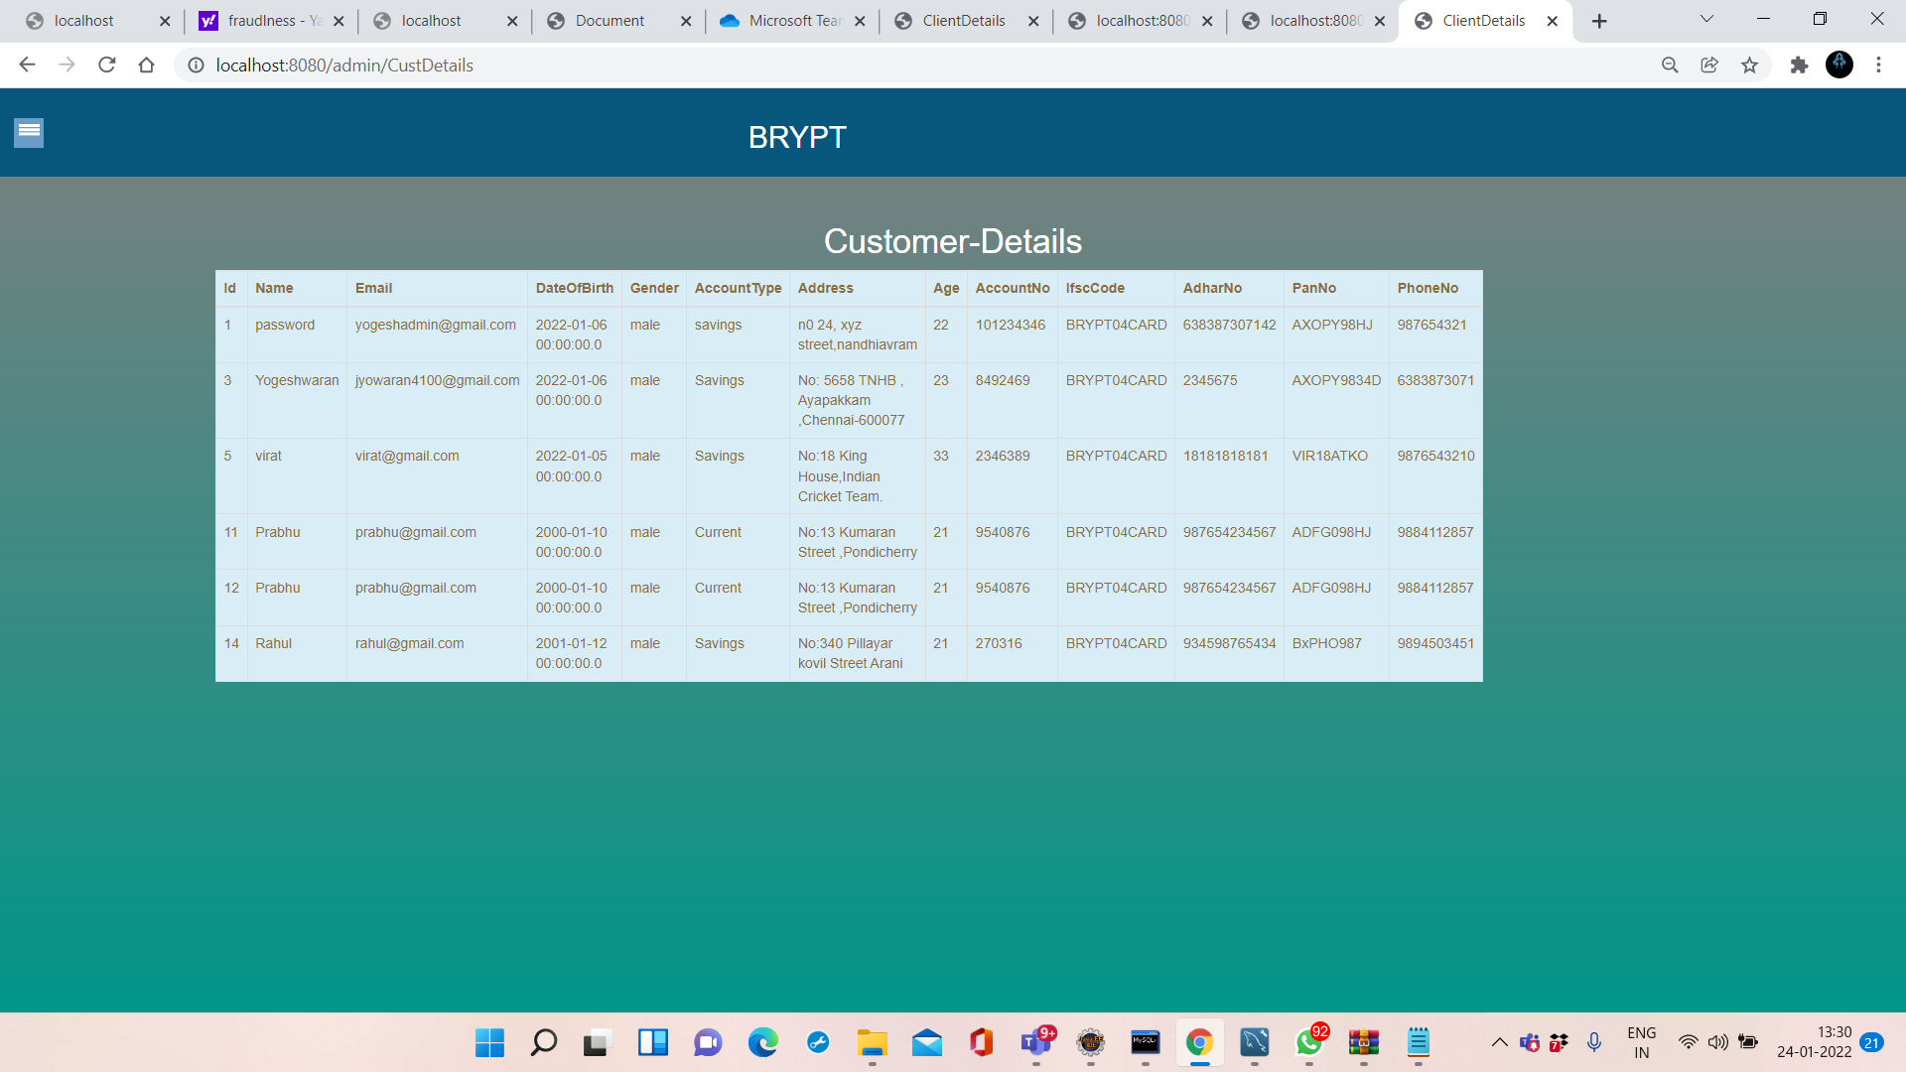
CUSTOMER LIST
__________________
From the dashboard, as shown in the previous image the admin can select the customer list option to display this page.
Here, the admin can view the full details of the customers of the BRYPT Bank from this branch.

Slide 20
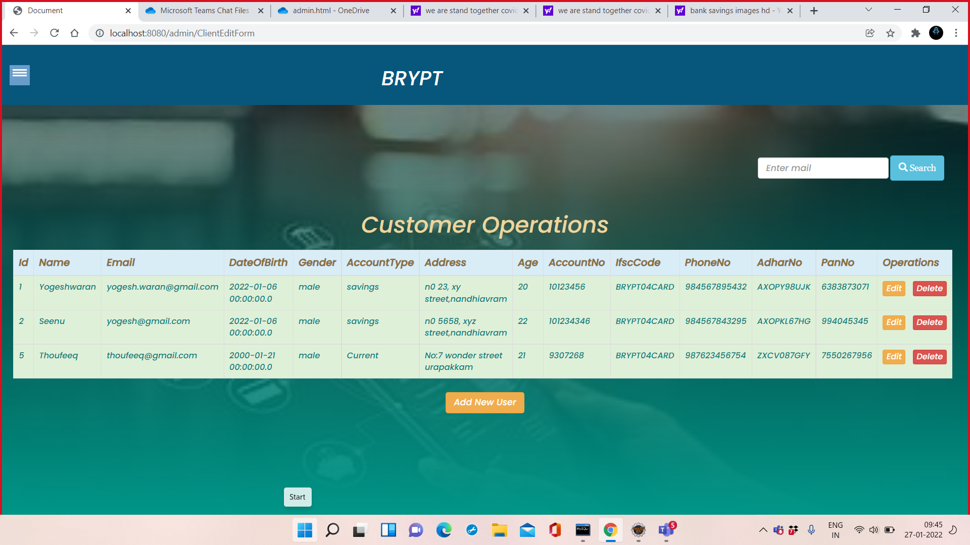
CUSTOMER OPERATION
___________________________
From the panel, the admin can select the customer operations option to view this page.
In this page the admin can edit the customer details or delete a customer completely.

Slide 21
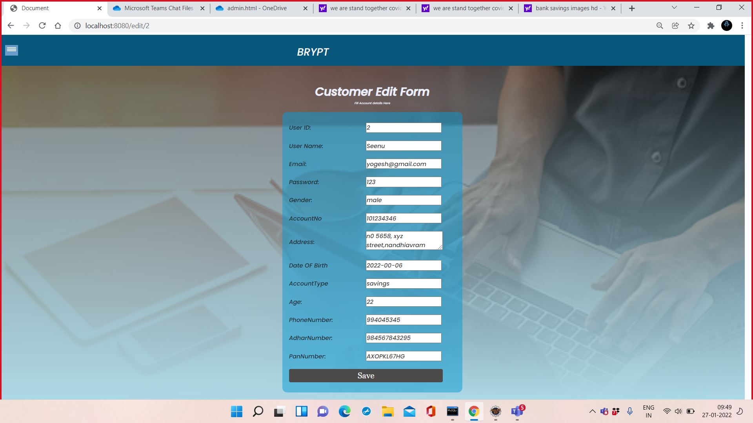
EDIT CUSTOMER
__________________
This page appears when the admin click the edit button from the customer operation page.
Here the admin can edit the information of a selected customer.

Slide 22
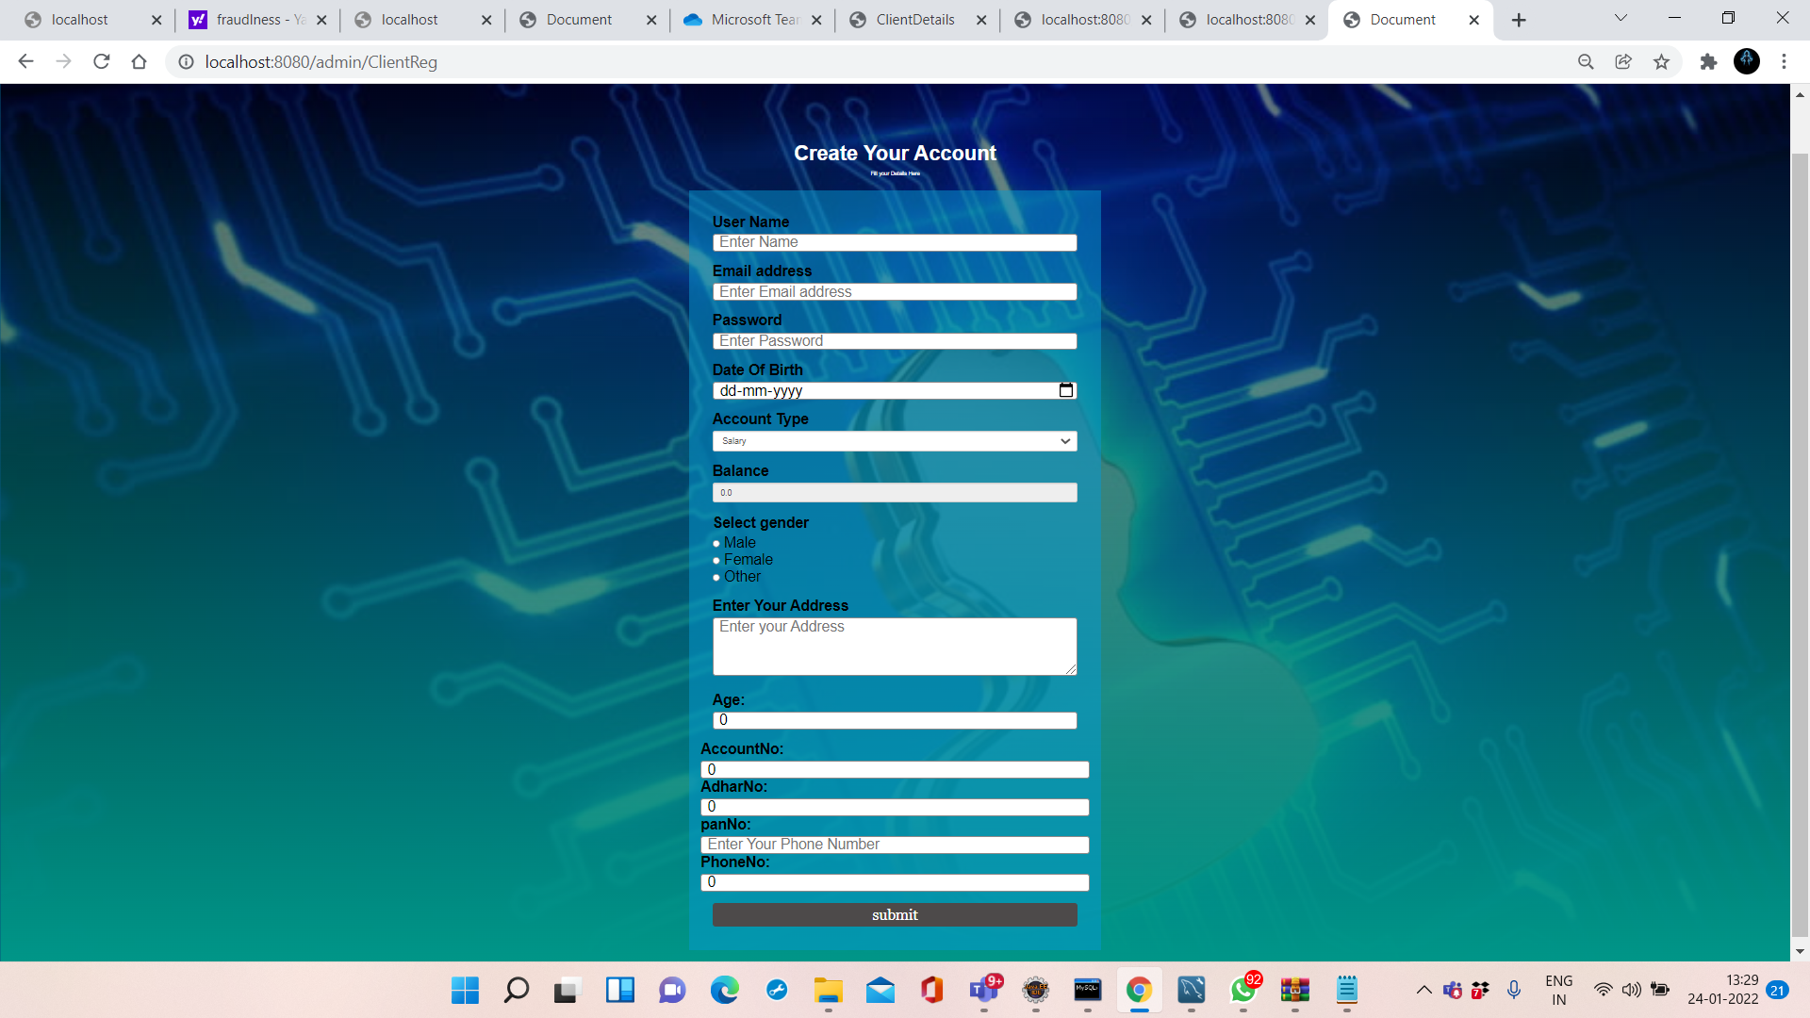
ADMIN’S CUSTOMER REGISTRATION
___________________________________
From the panel, the admin can select the Customer Registration option.
Here, the admin can create a new customer for the Brypt Bank.

Slide 23
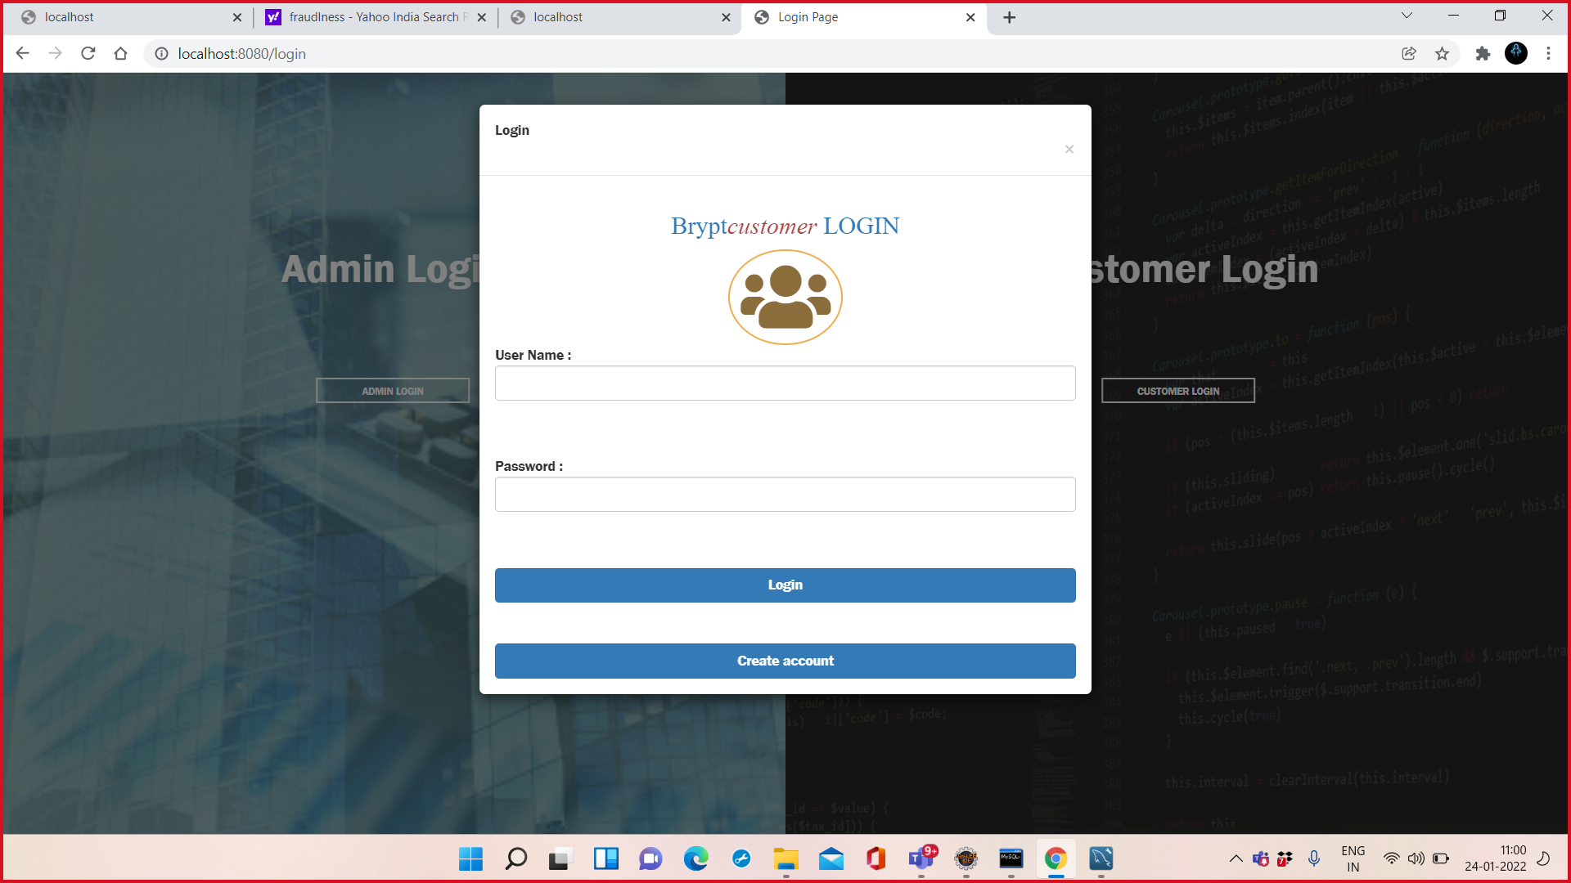
CUSTOMER LOGIN
______________________
Here, a pre-existing customer can login to their page or a new customer can register their details and create an account in the bank.
When customer enters correct username and password, they will be redirect to their dashboard.

Slide 24
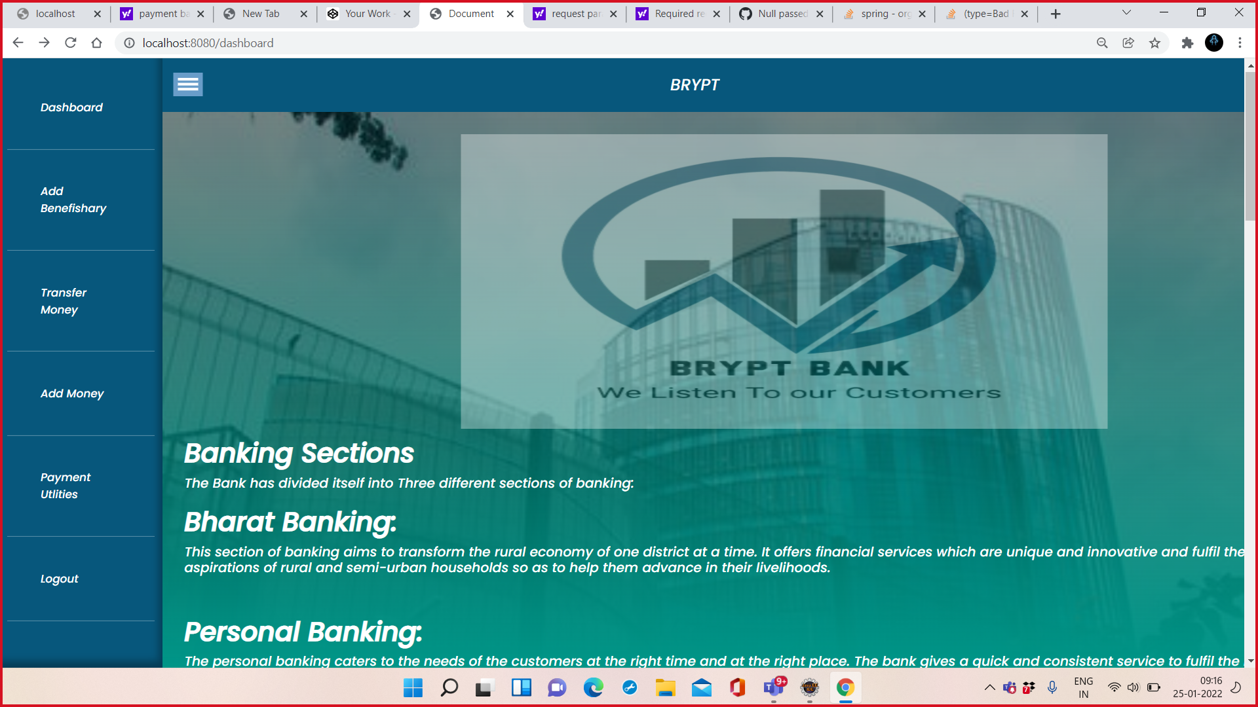
CUSTOMER DASHBOARD
_______________________
After entering the correct username and password, the customer is redirected to this dashboard.
Here, there is a brief details about the bank policies and customer have certain functions like add beneficiary, transfer money, add money and pay utilities.

Slide 25
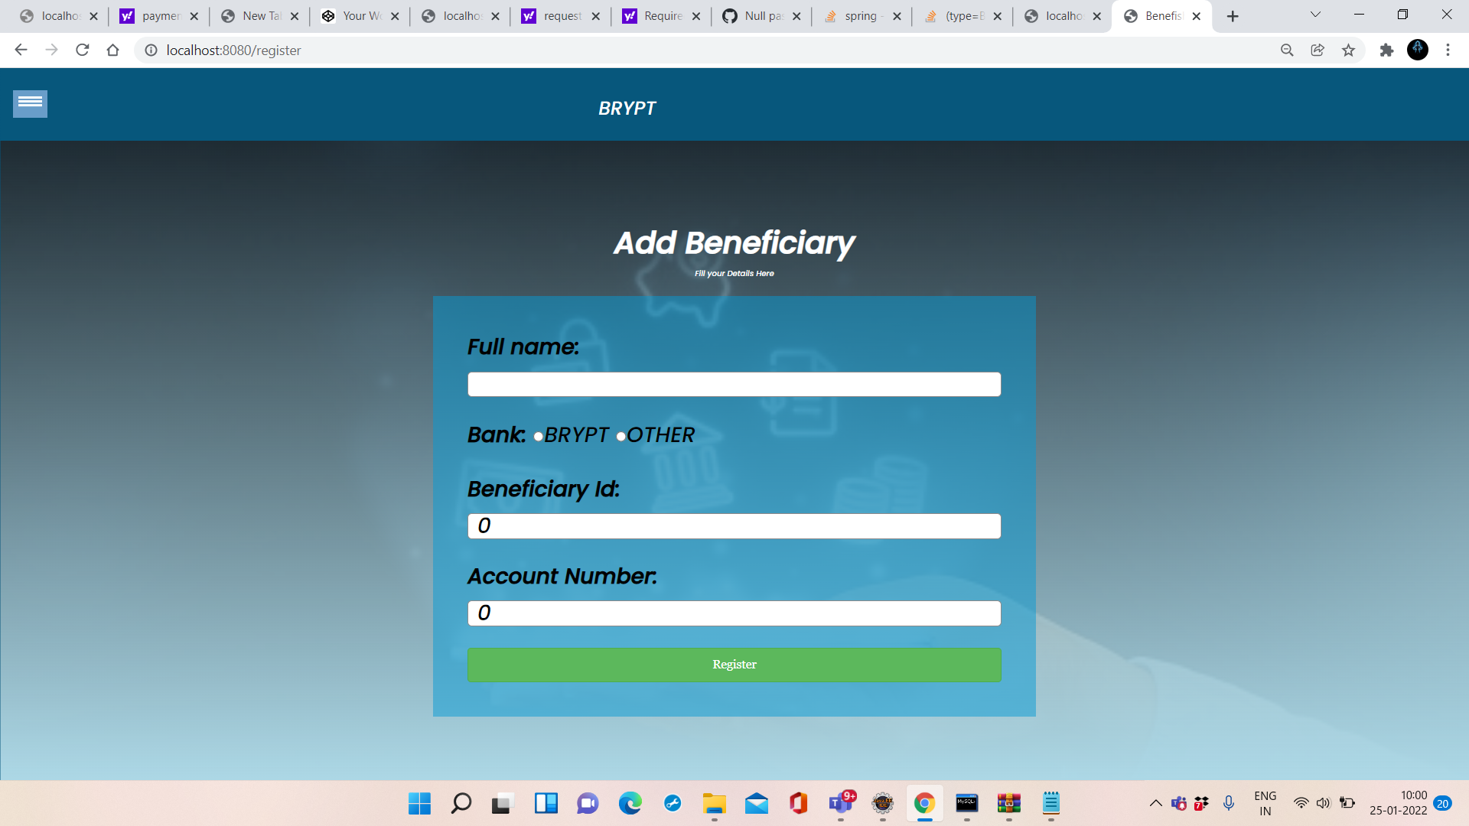
ADD BENEFICIARY
_____________________
From the panel the customer can select the add beneficiary option to add beneficiary.
After adding the beneficiary the customer can transfer money to that payee.

Slide 26
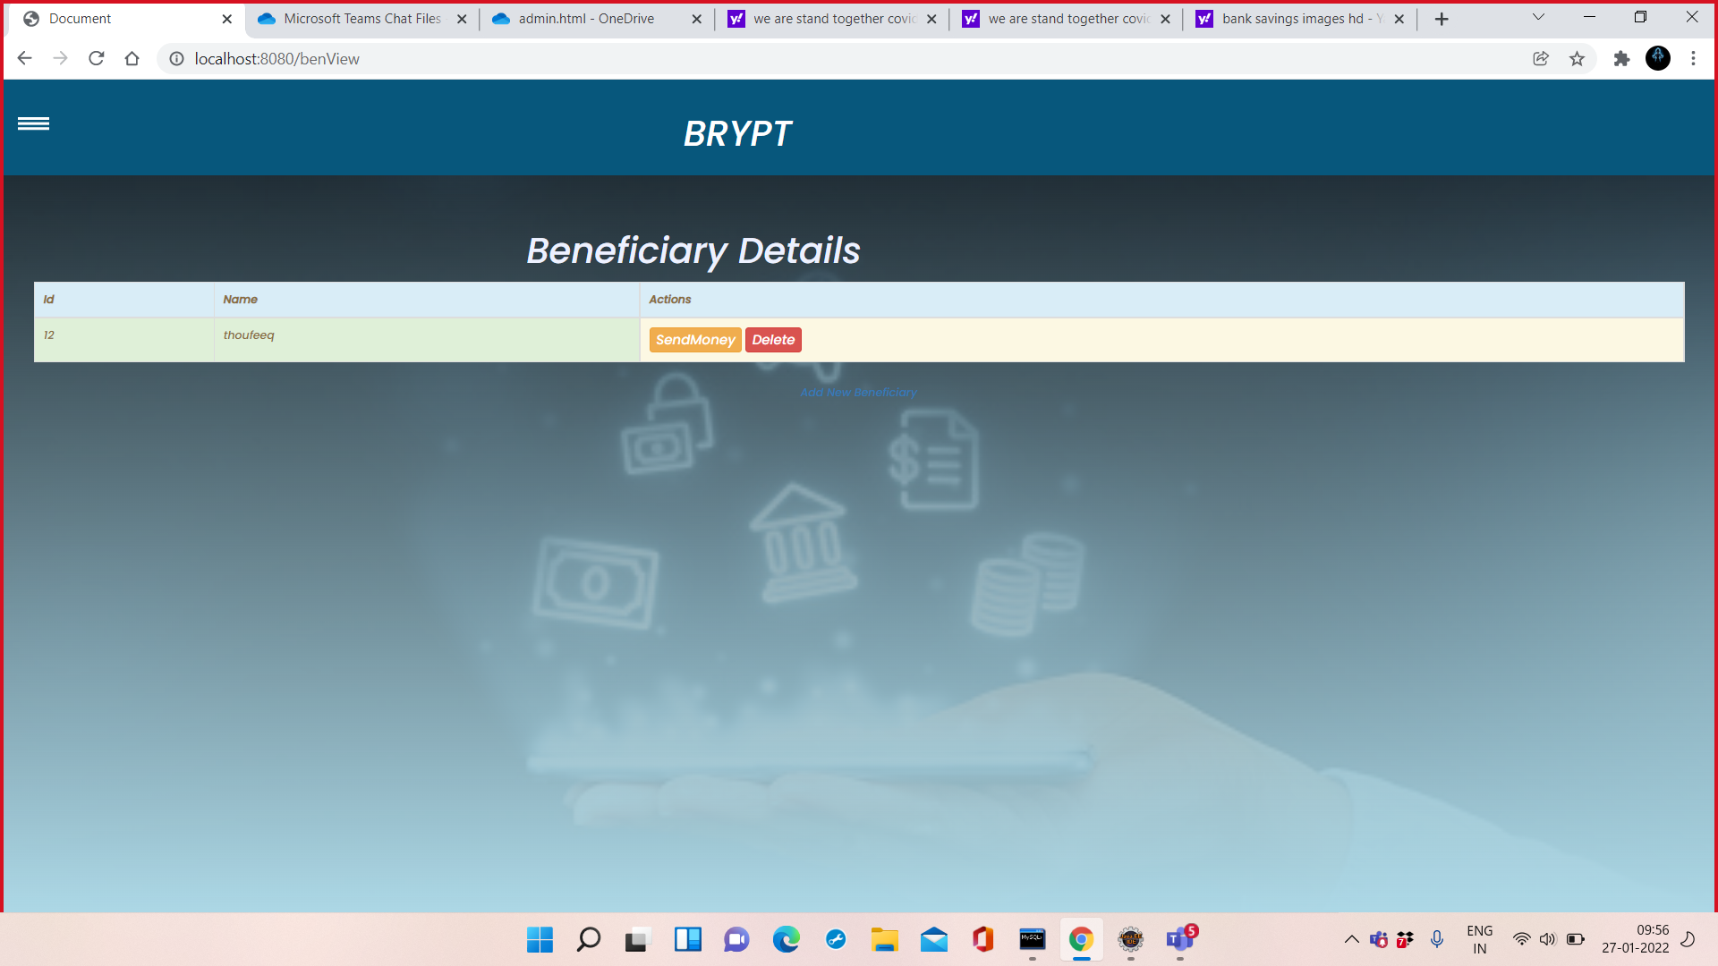
Beneficiary success page
________________________
This page appears after successful beneficiary registration.
Here, customer can delete their beneficiary.

Slide 27
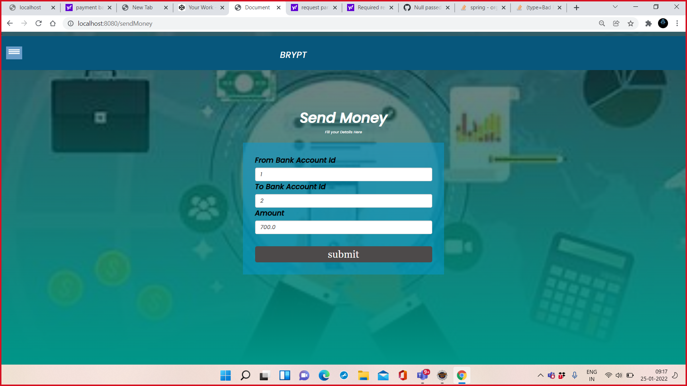
TRANSACTION
____________________
From the panel the customer can select the transaction option to transfer money to the beneficiary.
Here the customer can send money to the payee.

Slide 28
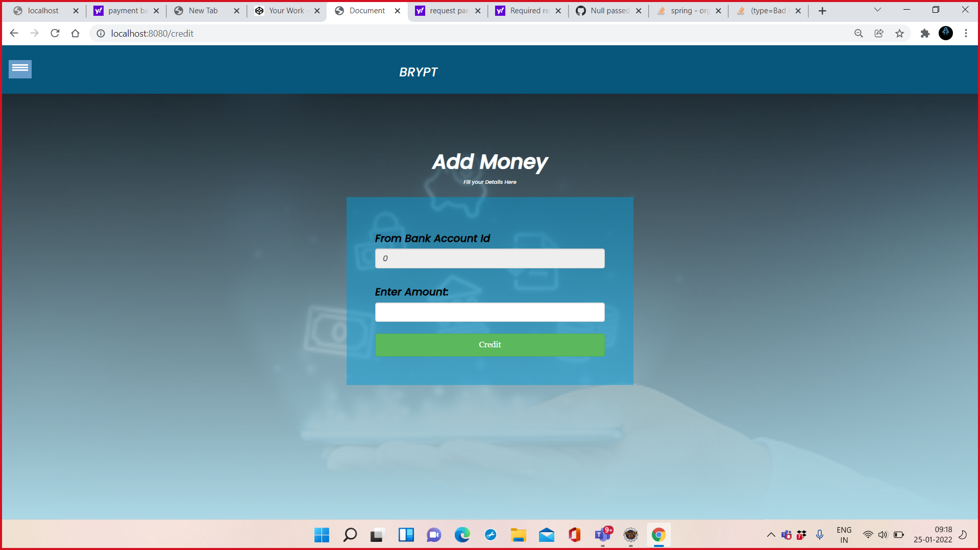
DEPOSIT MONEY
_________________
From the panel the customer can select the add money option to deposit money to their account balance.
Here the customer will enter the amount to be deposited to their bank account balance.

Slide 29
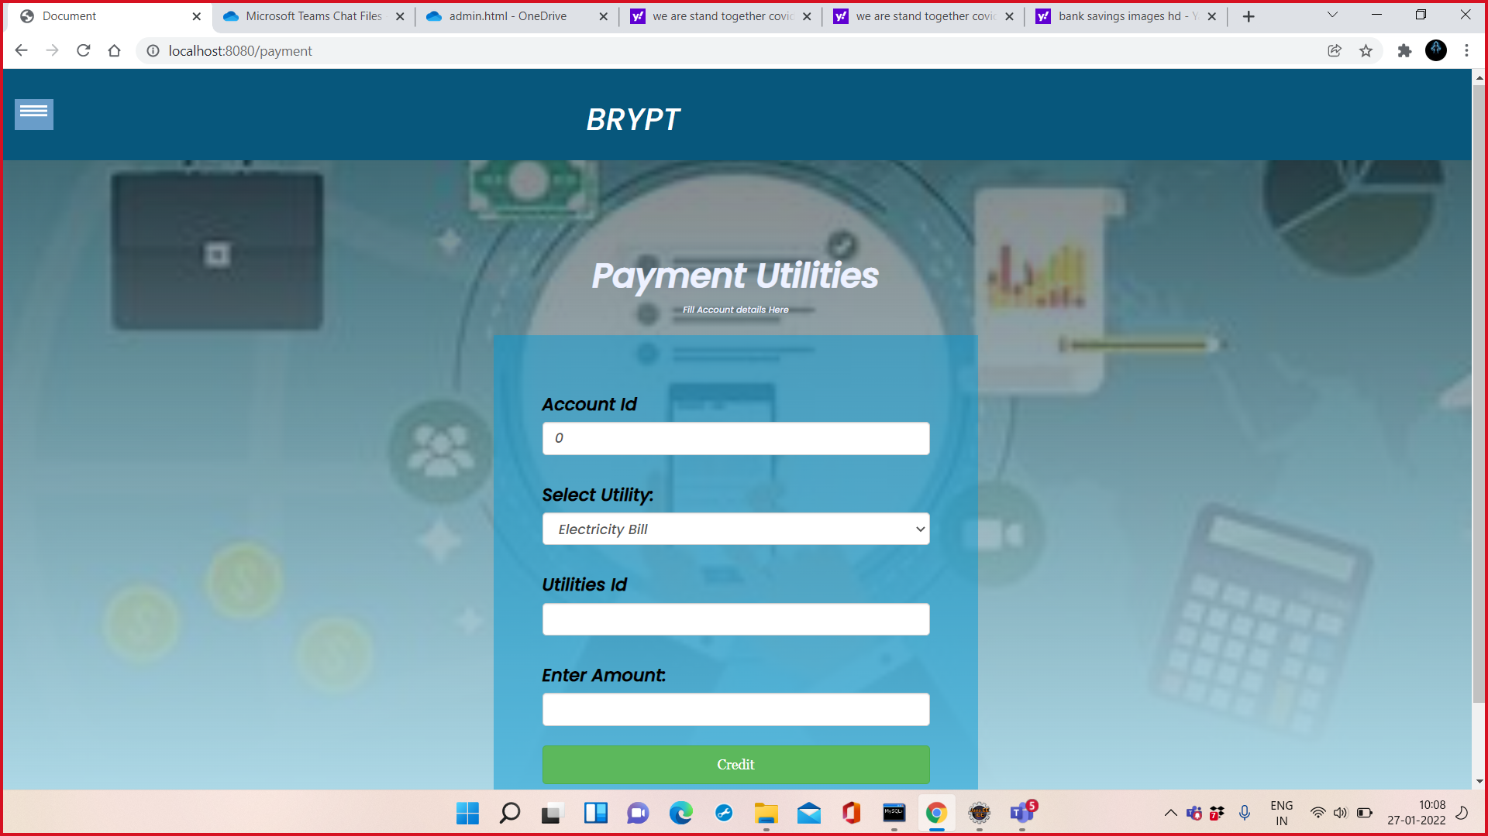
PAY UTILITIES
__________________
From the panel the customer can select the pay utilities option to transact money to pay utilities.
Here the customer can pay their expenses and amount will be deducted from their account,

Slide 30
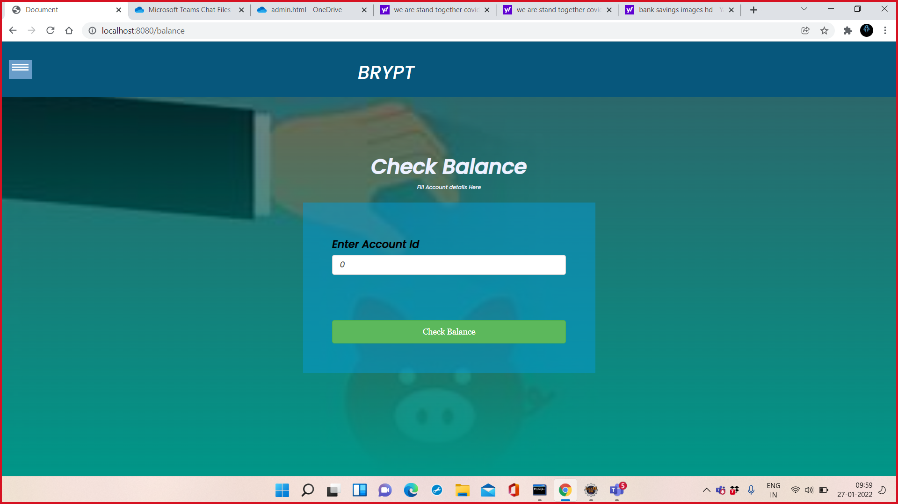
CHECK BALANCE
_______________________
From the panel the customer can select the check balance option to view their account balance.
Here the customer has to enter their id to get their account balance.

Slide 31
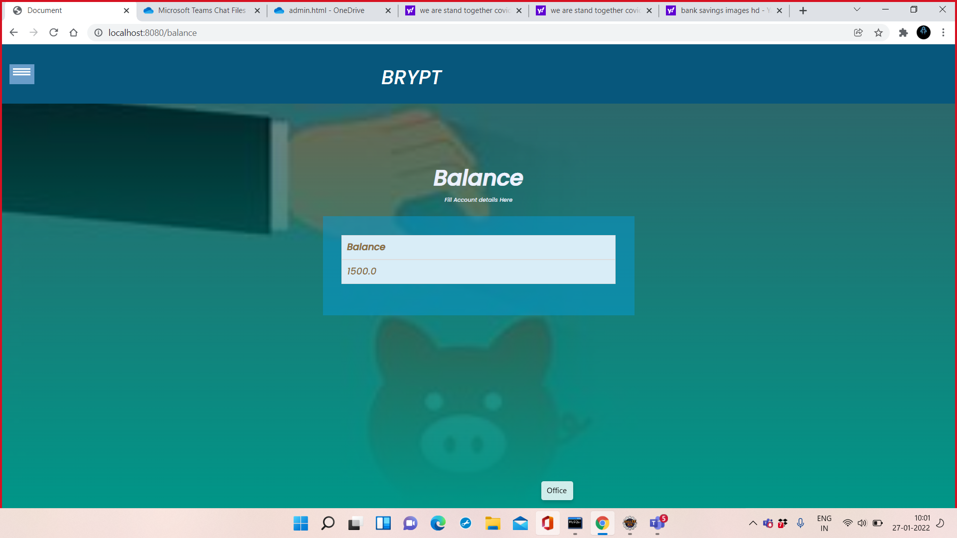
BALANCE
_____________
This appears after entering the customer id and it displays the customer account balance.

Slide 32

THANK YOU!

